Slide 1


DOM
Dissolved Organic Matter (2023SP)
Investigating the optimal conditions to remove humic acid in drinking water
More at https://github.com/AguaClara/Dissolved-Organic-Matter
Zachary Kwon | zk49@cornell.edu Nhi Nguyen | npn25@cornell.edu
Brooke Paykin | bsp67@cornell.edu Henry Lin | hl777@cornell.edu
Dissolved Organic Matter | Research | Symposium Presentation Spring 2023 | Page 1
Notes:
Brooke
We are the Dissolved Organic Matter (DOM) subteam. Our mission is to investigate the optimal conditions to remove humic acid (our tested form of dissolved organic matter) in drinking water. You all can find out more about our subteam’s work at this Github link. [Let everyone introduce themselves]

Slide 2
Table of Contents
Goal
Background
Relevance to Gracias Plant
Schematic Drawing
Experimental Setup
Current Work
Results and Analysis
Future Work
Dissolved Organic Matter | Research | Symposium Presentation Spring 2023 | Page 2
Notes:
Henry
Here is a general breakdown of our presentation today. We’ll start off with some general background and technical information before talking about our current research, results, and future plans.

Slide 3
Goal
To determine the effectiveness of implementing coagulant with clay and/or powdered activated carbon to remove humic acid from drinking water and improve the capability of AguaClara water treatment plants.
Dissolved Organic Matter | Research | Symposium Presentation Spring 2023 | Page 3
Notes:
Henry
Our mission this semester is to focus on determining the effectiveness of implementing coagulant with clay and/or powdered activated carbon to remove humic acid from drinking water to improve the capability of AguaClara water treatment plants.

Slide 4
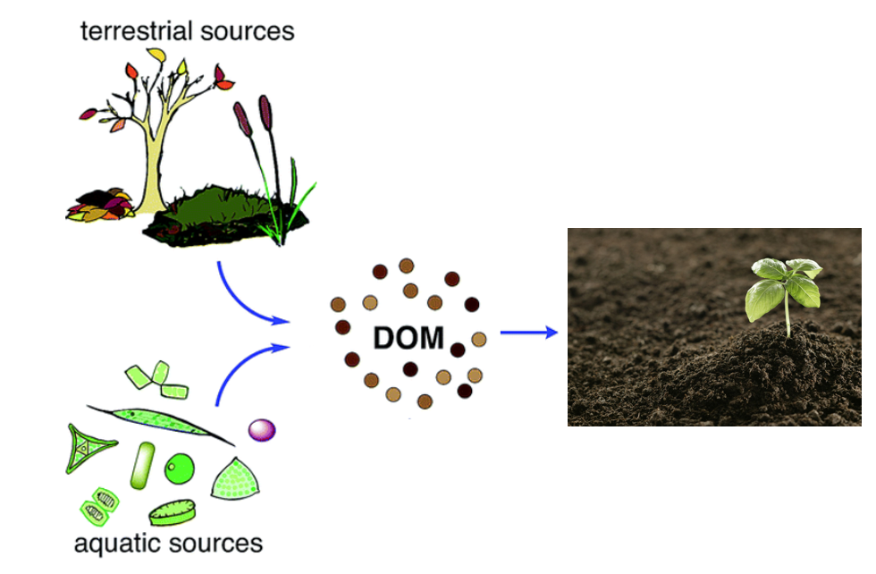
Background
What is humic acid (HA)?
Color, taste and odor problems
Increased heavy metals and organic pollutants
Reacts with chlorine to make chloroform
How can we deal with humic acid?
Flocculation
Coagulant (PACl)
w/ Clay
w/ Powdered Activated Carbon (PAC)
Figure 1. Formation of dissolved organic material from terrestrial and aquatic sources
Dissolved Organic Matter | Research | Symposium Presentation Spring 2023 | Page 4
Notes:
Henry
What is humic acid?
Humic acid is a type of Dissolved Organic Matter (DOM), which consists of particles present in surface and groundwater and mainly results from plant and animal decay. Although humic acid is beneficial to plants because of their stimulation for plant growth and increase of plant disease resistance, it is viewed as a problem for the drinking water treatment process.
This is because humic acid causes problems with the color, taste, and odor of drinking water and is associated with increased levels of complex heavy metals and adsorbed organic pollutants. In addition, humic acid has the ability to react with chlorine, which creates a harmful byproduct known as chloroform.
How can we deal with humic acid in drinking water?
Our subteam’s method for removing humic acid from drinking water is through a process known as flocculation. Flocculation is driven by coagulant, which is a substance that clumps the impurities in water together in bunches -called flocs- that can be easily removed in the sedimentation tank. In the past, we worked on determining a dosage of coagulant that is high enough to remove humic acid, but not enough to prevent flocculation.
After deciding on a set dosage of coagulant, we shifted our focus to finding the optimal coagulant to clay and/or activated carbon ratio that can maximize the amount of humic acid removed from the overall system.
Information Citation:
Radian, A., &amp; Mishael, Y. (2012). Effect of humic acid on pyrene removal from water by polycation-clay mineral composites and activated carbon. Environmental Science &amp; Technology, 46(11), 6228–6235. https://doi.org/10.1021/es300964d
Image citation:
Lin, V. S. (2015). Research highlights: Challenges in the characterization, storage, and isolation of natural organic matter. Environmental Science: Processes & Impacts, 17(12), 2002–2005. https://doi.org/10.1039/c5em90046h

Slide 5
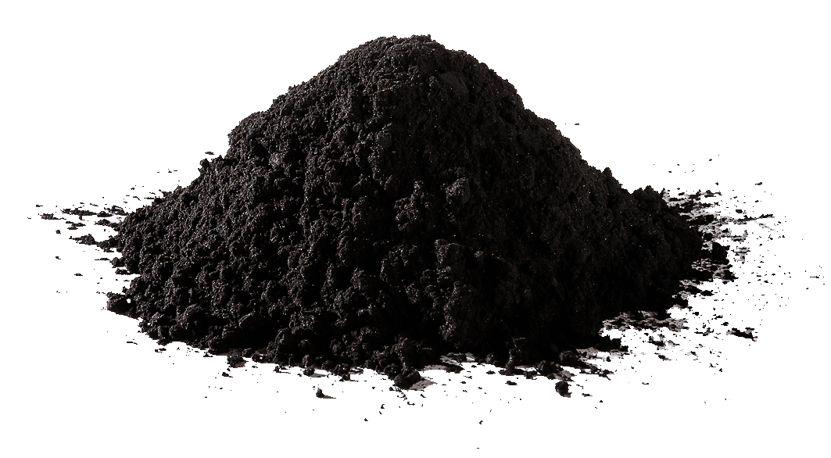
Background
How can clay and powdered activated carbon improve the flocculation process?
Create denser flocs
Porous and hydrophobic particles
Higher molar masses
Clay vs. Powdered Activated Carbon
Clay is less expensive
PAC is better at absorbing DOM
Figure 2. Powdered Activated Carbon (PAC) from Eleven Carbon Company
Dissolved Organic Matter | Research | Symposium Presentation Spring 2023 | Page 5
Notes:
Henry
How can clay and activated carbon improve flocculation?
Normally, according to Dr. Monroe Weber-Shirk, the flocs of humic acid and coagulant are not denser than water by themselves, which would cause problems during the sedimentation stage. In order to address this matter, clay and/or powdered activated carbon were introduced into the system. As a result, denser and heavier flocs are able to be formed and settle out of the system since these materials are known to be porous, hydrophobic, and have higher molar masses.
Clay vs. Powdered Activated Carbon
In a meeting with Dr. Weber-Shirk, we spoke about the difference between clay and powdered activated carbon. According to Dr. Weber-Shirk, clay is less expensive than PAC, but PAC is better at absorbing DOM. This statement was corroborated by a paper from Biswas et al. We plan to retrieve data justifying these statements and find optimal coagulant, clay, and PAC dosages to remove humic acid from drinking water.
Information Citation:
Biswas, S., Fatema, J., Debnath, T., &amp; Rashid, T. U. (2021). Chitosan–Clay Composites for wastewater treatment: A state-of-the-art review. ACS ES&amp;T Water, 1(5), 1055–1085. https://doi.org/10.1021/acsestwater.0c00207
Image Citation:
Powdered activated carbon. Eleven Carbon™. (2022, April 3). Retrieved October 17, 2022, from https://elevencarbon.com/powdered-activated-carbon/

Slide 6
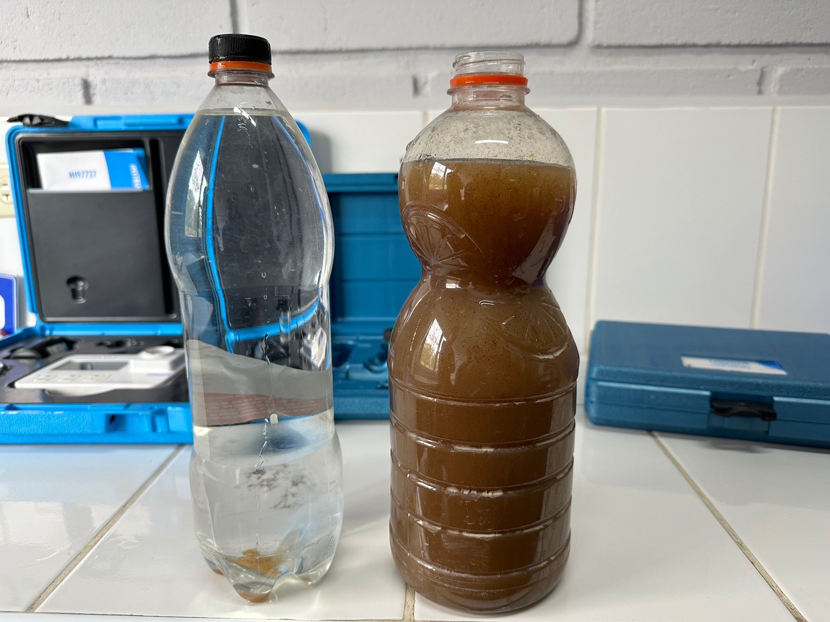
Relevance to Gracias Plant
Flocculation issues:
Leaves from sweet gum (liquidambar) tree
Pigments particles:
Too small for coagulant to combine
Reduce PaCl's effectiveness in flocculation
N.B. Operators estimate how much clay to add to help form flocs
Low turbidity of influent stream
Need turbidity to create flocs
Figure 3. Influent (left) and effluent (right) water from the Gracias plant (Honduras) during the rainy season
Dissolved Organic Matter | Research | Symposium Presentation Spring 2023 | Page 6
Notes:
Brooke
Why do we care?
because it affects the effectiveness of the gracias plant
gracias plant is the largest aguaclara plant, its flow is 120L/S
What caused the flocculation issue at the Gracias plant?
This influent stream has a partially high concentration of leaves from the liquidambar tree. the leaves have a pigment that gets into the water
the pigment is bad for aesthetic reasons, no one wants to drink brown water
but more importantly, the pigment is bad because it hinders the effectiveness of flocculation process.
so now, you are probably wondering, how do the pigments cause flocculation issues?
for one, the Pigments particles are too small to allow coagulant to combine to them
secondly, the pigment is so prevalent that it reduces the PaCl's effectiveness in helping floc forms.
currently in honduras, plant operators are adding clay to help flocs form.
extran info, dont need to say: but the operators are unsure how much to add. they are guessing. sometimes they could use too much or too little
Our task: we need to figure out a formula/ratio of how much clay to add (or other coagulant) that will allow flocs to form efficiently, and optimize costs.
We also need turbidity to create flocs
gracias has a low turbidity influent stream (during dry season) and this hinders the ability to form flocs
we are modeling this by using low turbidity setup in our lab to mimic conditions in gracias

Slide 7
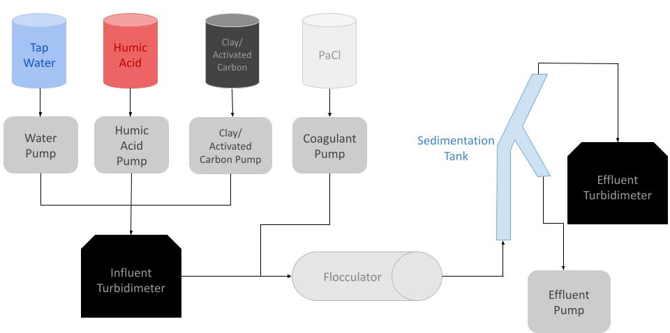
Schematic Drawing
Figure 4. Schematic drawing of the experimental set up for testing varying clay and/or activated carbon concentrations
Dissolved Organic Matter | Research | Symposium Presentation Spring 2023 | Page 7
Notes:
Nhi
We have a similar schematic for the other experiments we will like to run. The main differences is that there will not be clay added to the humic acid solution and that we will have another pump with activated carbon which will combine with humic acid and water before entering the influent turbidimeter.
The reason why there is a separate bottle for the clay solution is since we will be varying the flow rate of clay via ProCoDA to vary its concentration in the flocculator. The previous schematic is set up to
Have a dose of humic acid in clay solution so that the clay particle would be negatively charged and not agglomerate.
Facilitate manual change of clay concentration by adding more clay to the current stock humic acid and clay solution while ProCoDA’s flow rate is kept constant.
However, having a separate clay solution with a fixed concentration and only changing its flow rate into the system through ProCoDA allows for more flexibility and accuracy. The agglomeration of clay particles can be prevented by mixing a low dose of humic acid into the clay stock. With this in mind, we opt for this approach and schematic this semester.

Slide 8
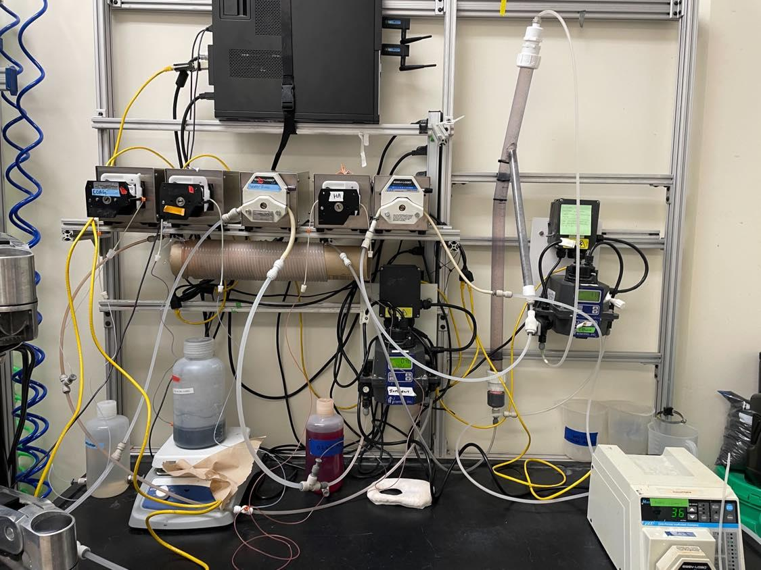
Experimental Setup
Water pump
Sedimentation tank
Coagulant pump
Wastewater pump
Clay/activated carbon pump
Humic acid pump
Effluent turbidimeter
Influent turbidimeter
Flocculator
Figure 5. Image of lab set-up and experimental design
Dissolved Organic Matter | Research | Symposium Presentation Spring 2023 | Page 8
Notes:
Henry
As you see from the schematic drawings, our system plays around five main pumps: one for coagulant, activated carbon, humic acid, and water. And an addition one for wastewater to ensure that the final solutions leaves the system.
As a general overscope of how system runs. (This portion is repeated already in Slide 7)
Water is pumped from the inlet and combines with the humic acid and activated carbon which then goes into the influent turbidimeter, which gives us our initial readings. Then coagulant is introduced into the stream and it passes through the flocculator. After the flocculator, the solution goes into the sedimentation tank, where the flocs are expected to settle out, and we are able to obtain our final readings in the effluent turbidimeter.

Slide 9
Current Work
Chose constant coagulant dosage (10 mg/L in flocculator)
Measured influent and effluent turbidity after varying clay stock concentration
Conducting flow rate tests for each pump
Track revolutions and volume pumped for certain time
Confirm upper limit for pump rotational speed (50 rpm)
Graph actual vs. ProCoDA flow rates and check pump conditions
Replace pump tubings
Dissolved Organic Matter | Research | Symposium Presentation Spring 2023 | Page 9
Notes:
Zach
Regarding the subteam’s current work, the constant coagulant dosage was set to be 10 mg/L in the flocculator. A constant coagulant dosage was chosen because a) it was simpler to conduct experiments by varying clay and powdered activated carbon dosages and b) plants in Honduras did not have one uniform coagulant dosage that they all used. After determining this dosage (10 mg/L in the flocculator) after deliberating with RA Rachel and Professor Monroe Weber-Shirk, investigations into the effect of different clay concentrations on effluent turbidity began. However, experimentation for this step was limited since Professor Weber-Shirk soon advised the team to pivot the methodology of the experiment to control the dosages with ProCoDA rather than changing the concentrations of the stock solutions. In order to restart experimentation, the pumps need to be tested individually to ensure that their flow rates are running accurately and adjustments are made if necessary (e.g., replacing old tubing, changing flow rates, etc.). Through tracking the number of revolutions and volume pumped within a certain time limit, the team was able to confirm the upper limit for the pump rotational speeds (50 rpm) and graph the actual flow rates against the ProCoDA flow rates.

Slide 10
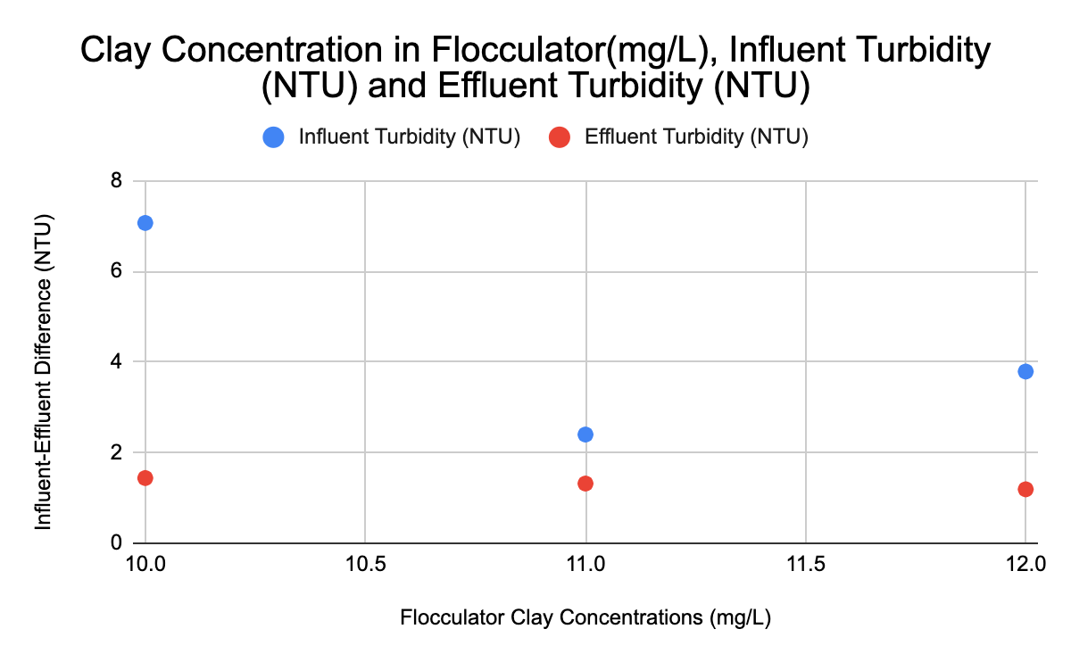
Results and Analysis (1)
Figure 6. Influent (blue) and effluent (red) turbidity values from different clay concentrations in flocculator.
Dissolved Organic Matter | Research | Symposium Presentation Spring 2023 | Page 10
Notes:
Nhi
Even though there are disparities in the relationship between the influent turbidity and clay concentrations, there is a clear downward trend in the effluent turbidity values as the amount of clay in the flocculator is increased. While this test was performed before fully understanding each pump’s rotational speed, the data supports our hypothesis that adding more clay allows for denser flocs that settle better in the sedimentation tank, resulting in less turbid effluent water.

Slide 11
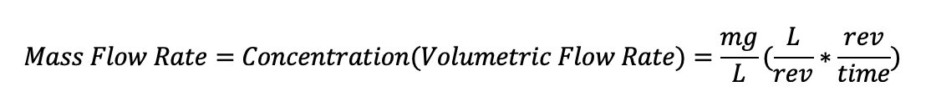
Results and Analysis (2)
Dissolved Organic Matter | Research | Symposium Presentation Spring 2023 | Page 11
Notes:
Zach
This mass flow rate equation is an integral part of the setup for this experiment. So far, the concentrations of the stock solutions had been changed each time we wished to change the mass flow rate. However, we were advised by Monroe to instead change the volumetric flow rate on ProCoDA instead of creating new concentrations every time. Breaking down the equation further, the L/rev factor should be constant because the pump setup should remain the same for the entirety of the experiment. We will go more in detail on this in the next slide. That means that the true variable in this equation is the rev/time factor, which we will need to vary in order to test different dosages of clay and activated carbon.

Slide 12
Results and Analysis (3)
Table 1. Data for Volumetric Flow Rate Tests before Replacing Tubing
Pump Type | Overhead Type | ProCoDA Volumetric Flow Rate (mL/s) | volume per rev (mL/rev) | Revolutions per time (rev/s) | Actual Volumetric Flow Rate (mL/s)
Coagulant | Ismatic | 0.05 | 0.1005 | 0.342 | 0.0343
 |  | 0.1 | 0.102 | 0.673 | 0.0686
 |  | 0.2 | 0.1023 | 0.828 | 0.0847
 |  | 0.2 | 0.1029 | 0.864 | 0.0890
 |  | 0.3 | 0.1033 | 0.843 | 0.0871
Clay/Activated Carbon | Ismatic | 0.1 | 0.13 | 0.667 | 0.0867
 |  | 0.2 | 0.1274 | 0.834 | 0.106
Water | Masterflex | 0.25 | 2.705 | 0.0902 | 0.244
 |  | 0.3 | 2.7 | 0.106 | 0.285
 |  | 0.5067 | 2.688 | 0.182 | 0.490
 |  | 0.75 | 2.536 | 0.275 | 0.698
Dissolved Organic Matter | Research | Symposium Presentation Spring 2023 | Page 12
Notes:
Zach
This data table represents the results for the volumetric flow rate tests taken before replacing old yellow-blue tubing. In the yellow-highlighted column, the volume per revolution values for each respective pump setup are relatively constant. This makes sense since the amount that is pumped after one pump revolution should be the same. However, the coagulant and clay/activated carbon pump setups should have been identical (Ismatic overheads with yellow-blue tubing), but this was not reflected in the volume per rev (~0.102 for coagulant and ~0.129 for clay/activated carbon).
The green highlighted columns represent the volumetric flow rate listed on ProCoDA and the actual volumetric flow rate calculated in the flow rate tests. In order to visualize this data better, Nhi will explain with graphs of the Coagulant and Water pumps’ volumetric flow rates.
~ Monroe suggested that this was because the yellow-blue tubing had become too overused, which makes sense since the coagulant pump tubing had been used much more than the clay/activated carbon pump tubing in the experimentation thus far. Therefore, it was decided that the yellow-blue tubing needed to be replaced for the relevant pumps and more testing would need to be done for more data on the clay/activated carbon, humic acid, and effluent pumps.~

Slide 13
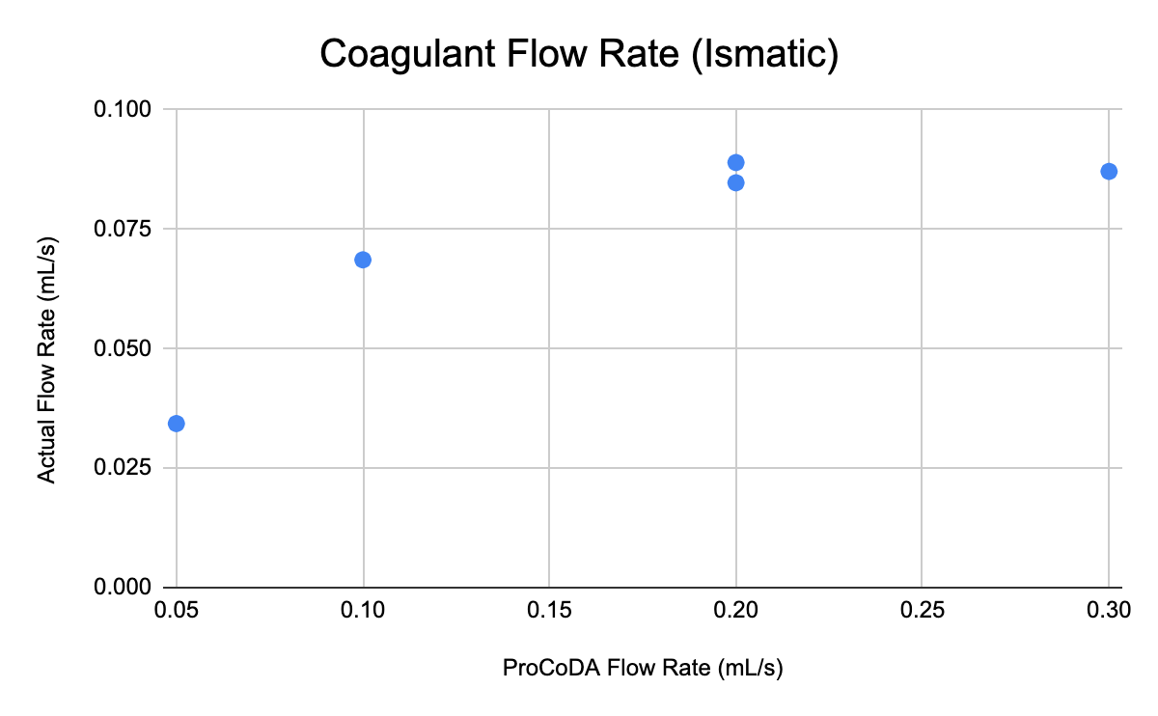
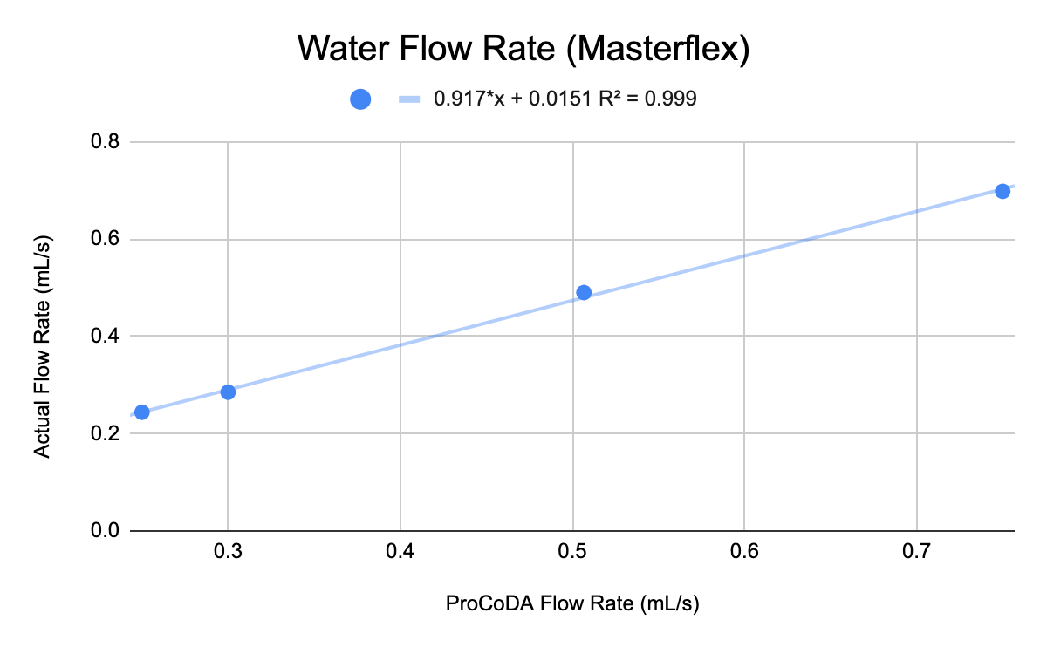
Results and Analysis (4)
Figure 7. Plots of relationship between ProCoDA flow rate and actual flow rate of coagulant pump with Ismatic head (left) and water pump with Masterflex head (right).
Dissolved Organic Matter | Research | Symposium Presentation Spring 2023 | Page 13
Notes:
Nhi
We expect a linear trend between the flow rate set in ProCoDA and the actual flow rate through the system. Because when we set the speed for the pump the only parameter that is accurate to the settings is vol per rev. The flow rate, vol per time, vary per pipe diameter basis.
For the picture on the right, we can a clear linear trend. However, for the left graph, actual flow rate levels off even when we continue increase the values on ProCoDA pass 0.2 ml/s. This lead to the speculation that there’s an upper limit for the flow rate of the pump, and this is unique for each pump so that what’s we will be investigating this semester.

Slide 14
Future Work
Find optimal clay and activated carbon dosages for set coagulant
Vary ProCoDA flow rates
Create more concentrated solutions
Analyze the efficiency and financial trade-offs between utilizing clay and/or powdered activated carbon
Dissolved Organic Matter | Research | Symposium Presentation Spring 2023 | Page 14
Notes:
Brooke
Our goal is to to find the optimal dosage of clay and activated carbon. First we will test clay, then we test activated carbon.
As well collect data, we will be using procoda to vary the flow rates of our pumps. This is much less time consuming than continuously making new stock solutions to vary concentrations, which is what we used to do.
We will be also create more concentrated stock solutions for clay, coagulant, and activated carbon. Making more concentrated solutions has two major benefits:
one: our scale is not accurate for low values. if our solution is more concentrated, then this error becomes less significant
two: Right now we have an upper limit for the pumps rpm. by having more concentrated solutions, we have the ability to access a wider range of coagulant dosages because we can manipulate our flow rate. So essentially, we are making our data less limited.
once we have more data we will be able to analyze the efficiency and financial tradeoffs

Slide 15
Questions
and/or
Recommendations?
Zachary Kwon | zk49@cornell.edu Nhi Nguyen | npn25@cornell.edu
Brooke Paykin | bsp67@cornell.edu Henry Lin | hl777@cornell.edu
Dissolved Organic Matter | Research | Symposium Presentation Spring 2023 | Page 15
Notes:
Brooke
Thank you for listening to our presentation. If you have any questions or recommendations, feel free to contact anyone on the team!

Slide 16
References
Logan, B. E., Hermanowicz, S. W., & Parker, A. S. (1987). A Fundamental Model for Trickling Filter Process Design. Journal (Water Pollution Control Federation), 59(12), 1029–1042.
Matilaninen, A, Vepsalainen, M & Sillanpaa, M. (2010). Natural Organic Matter Removal by Coagulation during Drinking Water Treatment. Adv Colloid Interface Sci.
Soh, YC, Roddick, F & Van Leeuwen, J. (2008). The Impact of Alum Coagulation on the Character, Biodegradability and Disinfection By-product Formation Potential of Reservoir Natural Organic Matter (NOM) Fractions. Water Sci Technol. 58(6), 1173-9.
Kopfler, F., H. Ringhand, W. Coleman, AND J. Meier. REACTIONS OF CHLORINE IN DRINKING WATER, WITH HUMIC ACIDS AND 'IN VIVO'. U.S. Environmental Protection Agency, Washington, D.C., EPA/600/D-84/196 (NTIS PB85160737).
Du, Y. (2017). Observations and a Geometric Explanation of the Effects of Humic Acid on Flocculation.
Lin, V. S. (2015). Research highlights: Challenges in the characterization, storage, and isolation of natural organic matter. Environmental Science: Processes & Impacts, 17(12), 2002–2005. https://doi.org/10.1039/c5em90046h
Powdered activated carbon. Eleven Carbon ™. (2022, April 3). Retrieved October 17, 2022, from https://elevencarbon.com/powdered-activated-carbon/
Dissolved Organic Matter | Research | Symposium Presentation Spring 2023 | Page 16

Slide 17
Appendix
Slides
Dissolved Organic Matter | Research | Symposium Presentation Spring 2023 | Page 17

Slide 18
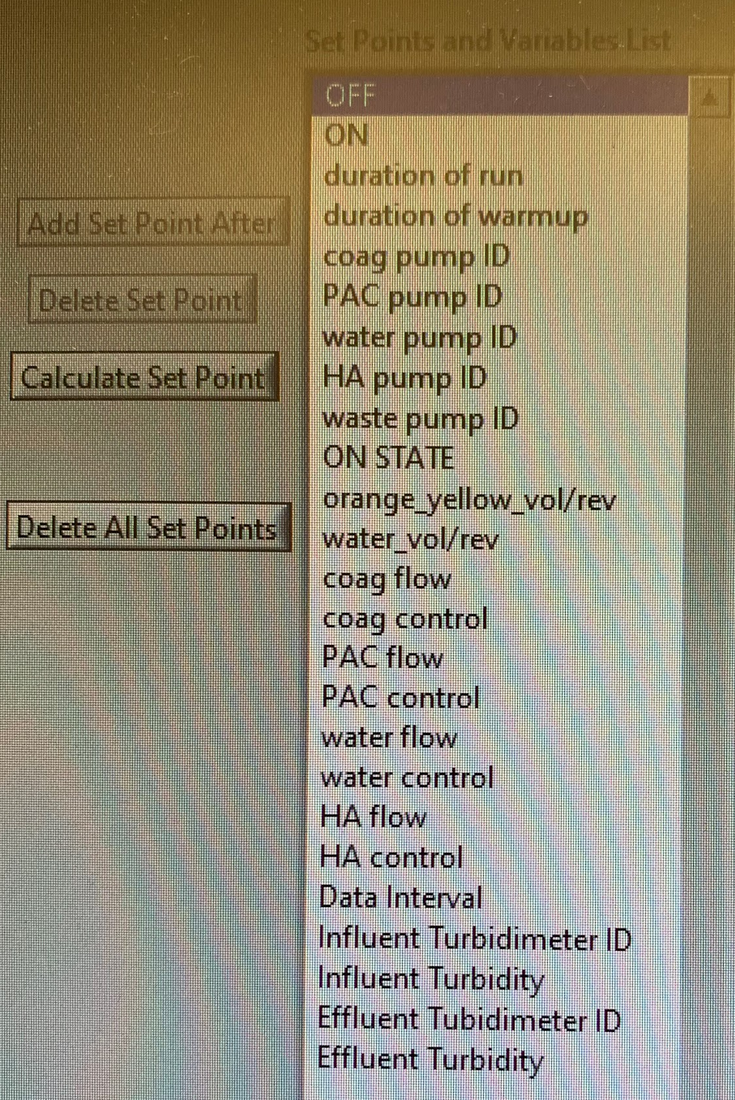
Setpoints
Figure 10: Image of the setpoints of the ProCoDA method file
Link to ProCoDA Method File: https://github.com/AguaClara/Dissolved-Organic-Matter/blob/main/DOM%20Updated%2002052023.pcm
Dissolved Organic Matter | Research | Symposium Presentation Spring 2023 | Page 18
Notes:
Attached above is an image of our ProCoDA setpoints and a link to the DOM Updated 02/05/2023 ProCoDA method file on Github

